Slide 1

Coming soon to e-Discharge Letters
Palliative Care Team
Fiona Read/ Charmaine Butcher
June 2020

Slide 2
The idea for GREAT
The Dudley group originally developed GREAT which has proved successful in improving communication between primary and secondary care settings.
The UHNM hospital palliative care team recently piloted the use of the GREAT acronym poster that we are now planning to roll out across the Royal Stoke and County Hospitals.
The GREAT acronym will be used by those writing e-discharge letters to ensure adequate information is shared, concerning patients who are being discharged out of the trust who have a palliative diagnosis and are receiving End of Life Care (Last 12 months of life).

Slide 3
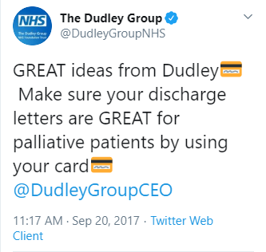
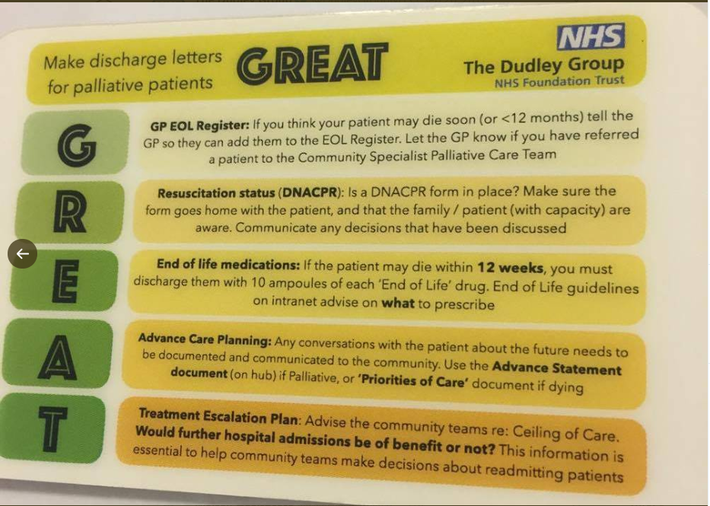
The Dudley Group - 2017
We liaised with Dr Richard Alleyne,
Consultant in Palliative Medicine. Dudley Group NHSFT. He was very happy for us to use and create our own version of the poster.

Slide 4
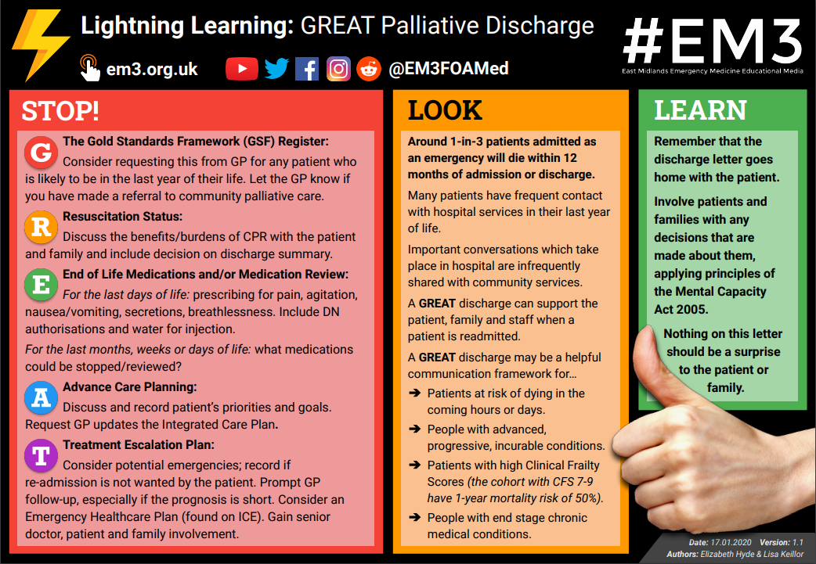
East Midlands Emergency Medicine Educational Media
East Midlands Hospitals recently created a Lightening Learning Package : GREAT Palliative Discharge.
https://em3.org.uk/foamed/11/3/2019/lightning-learning-great-palliative-discharge

Slide 5
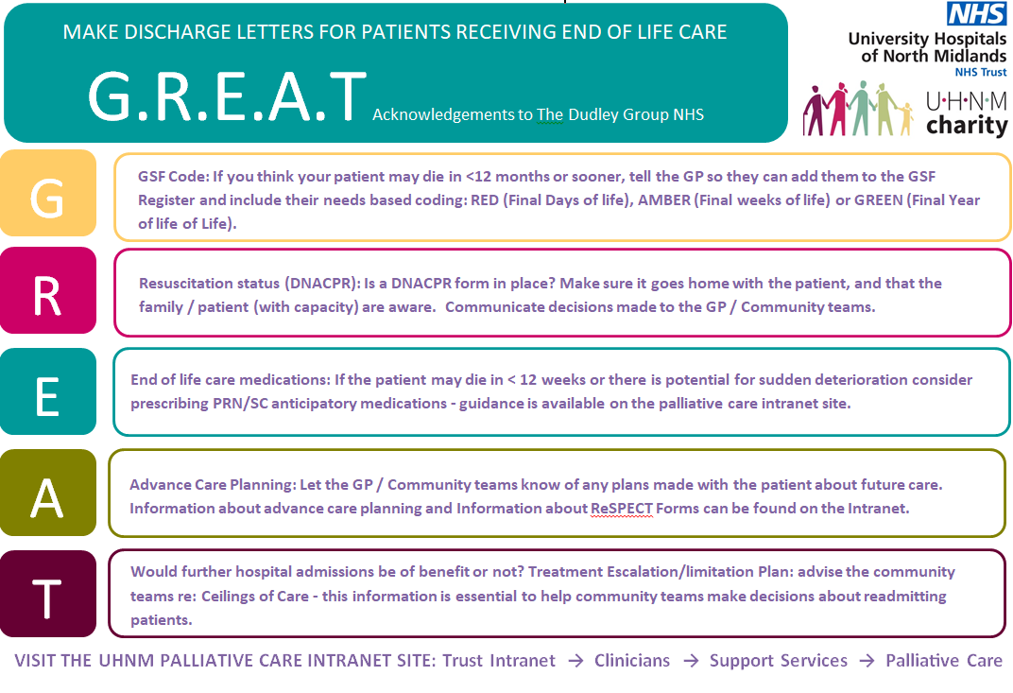
UHNM Palliative Care Team Final Design in conjunction with UHNM Charity 2019/2020

Slide 6
Why is this GREAT important?
Often a change in the patient’s trajectory of their illness and hospital admissions can indicate that the patient maybe entering the last 12 months of their life.
1 in 3 patients admitted as an emergency will die within 12 months of admission or discharge. Many patients have frequent contact with hospital services in their last year of life.
Important conversations which take place in hospital are infrequently shared with community services.
Often patients are seen by the hospital palliative care team in the last days of their lives, when they are too poorly to communicate what their wishes would have been at that time.
Issues in the community and at emergency portals with poor information about previous conversations/patients wishes for plan of care in last 12 months of life.

Slide 7
Trial of G.R.E.AT at UHNM
15/05/19 – 15/06/2019- Acronym poster in its infancy piloted on respiratory wards 222 and 12 County
Suggestions/Feedback from clinicians:
Communicate GREAT to community colleagues (on rolling out trust wide) ie: CCGs, GP networks, Nursing Homes.
Whether a GREAT alert could be added to i-portal which could then be accessed by emergency portals.
Whether GREAT could have a tab on e-discharge letters
Ideas for future audits: reduction in admissions, reviewing prognosticating.

Slide 8
UHNM Palliative Care December 2019 Audit
July 2019 – 50 patients’ notes reviewed from 1 weeks MDT list
27 patients at point of referral died in hospital.
(This is comparative to our other mini audits demonstrating that almost 60% of patients died within 3 days of referral and 75 % within 7 days).
Out of the other 23:
1 was non-palliative
2 were discharged continuing on active palliative treatment. (1 of whom had 3 further admissions and died in AMU)
3 were discharged to a hospice.
17 out of the 50 of that weeks MDT list of patients were identified as palliative fast track discharges to either Own Home or Nursing home. 1 of these 17 was a known high attendee and known to High Intensity Team.

Slide 9
Summary of Audit Findings
We reviewed the 17 patients who were identified as fast track and audited their discharge letters.
Anticipatory medications - 4 had correctly listed anticipatory medications . 1 had half the correct medications. 12 as it appears on their discharge letter did not have anticipatory medications prescribed.
Treatment Limitation Escalation plan - 8 had a documented plan. 7 had a half plan, (essentially plan was unclear). 5 had no plan of any description.
Had future hospital admission been discussed/documented? - For a fast track palliative discharge – usually the patient is rapidly deteriorating and all of these patients are likely identified as not appropriate for hospital re-admission, with a estimated prognosis of less than 3 months.
- 7 patients - this was clearly discussed and documented.
- 9 patients - were unclear.
- 1 patient - was for on-going palliative oncology follow up.

Slide 10
Summary of Audit Findings
Re-admissions? - Total of 8 out of the 17 patients were readmitted.
-3 patients died in hospital on readmission or shortly after.
-3 patients had further conversations around treatment escalation/limitation plan (TELP) and were discharged again via Fast Track. (The plan and anticipatory medications etc were clearer on their second discharge letters it was noted).
-1 patient was known to the High Intensity Team (HIT) who had multiple further admissions but not referred to palliative care again since July.
-1 discharged from hospital - still with no clear ceilings in care.
No further hospital admissions: 9 patients
-5 of whom have since died in the community.
-2 patients –Unclear if still alive at time of audit.
-1 patient - still being seen by acute oncology – no clear TELP documented
-1 patient - required on-going phone calls frequently to EAU, then had an OPA which prompted TELP and patient died in the community.

Slide 11
We also reviewed discharge letters and hospital admissions for the 27 patients who died at point of referral.
The purpose was to try and gain information about the QUALITY of discharge letters and also to highlight the number of opportunities some patients may have had as an I/P to broach care planning for the last 6- 12 months of life.
9 had no admission in the previous 6 month period.
18 had been previously admitted (5 of which were previously known to SPCT, 3 of them only the previous month of June. All were within the last 6 months. )
It was clear that there were missed opportunities at this time for these patients to have had earlier conversations.

Slide 12
Patient case study 76yr old lady
Mrs Smith Admitted 16/7/19 with breathing difficulties, acute Respiratory failure type 2 (only discharged previous day) 6th admission this year
PMH: COPD - emphysema, LTOT, home nebs known CO2 retainer (FEV1 30% in 2018) diabetes, Osteoarthritis, NOF surgical reduction, DNAR
Treated with nebs IV Levofloxacin steroids, NIV
16/7/19 ceiling of care = NIV, not for invasive ventilation
17/7/19 - not for further NIV, hospital palliative care review
17/07/19 –We reviewed Mrs Smith who expressed that she was not keen for further NIV even if life threatening situation
18/7/19 medically fit for discharge

Slide 13
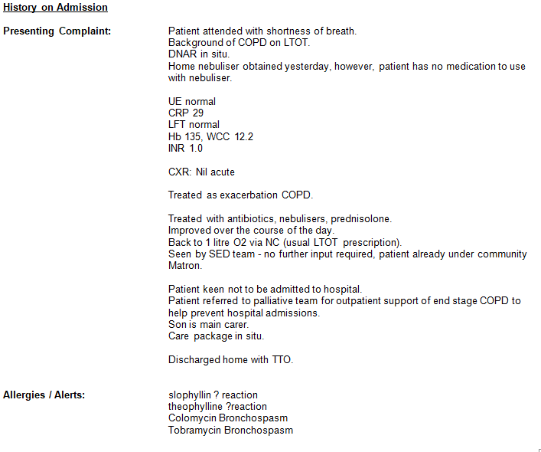
Previous e-Discharge letter (June 2019)

Slide 14
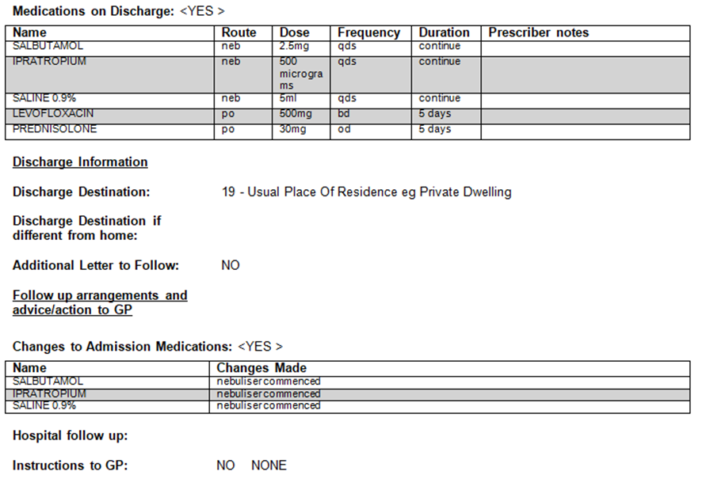
No Anticipatory Medications Prescribed at this time…

Slide 15
Patient case study – 76yr old lady
Mrs Smith was discharged as fast track palliative with increase in package of care. Her e-discharge letter on the 31st of July concluded:
“Mrs XXXXX has been seen by palliative team and is now a fast track discharge and will be discharged with anticipatory end of life medication, and recommend that she is placed on the GSF. Mrs XXXXX has a DNAR in place.”
Mrs Smith was re-admitted on the 24/08/2019 and died in A&E. Due to her last e-discharge letter clinicians knew she did not want NIV on this final admission.
In the last 4 months of her life she had 7 admissions to hospital.

Slide 16


Information now included on discharge letters.
What is GSF in practice? GSF - right person, right care, right place, right time, every time.
GSF both influences national policy developments, and helps put policy into practice on the ground supporting grass-roots change in line with NHS Long Term Plan, NICE Guidance, Enhanced Health in Care Homes, DH EOLC Strategy, Ambitions Care Quality Commission (CQC), and Skills for Care etc.
Actions required for GP
  Check patient is registered appropriately for the phase of their illness.

Slide 17

Information now included on discharge letters.
Resuscitation status (DNACPR): Is a DNACPR form in place? Make sure it goes home with the patient, and that the family / patient (with capacity) are aware. Communicate decisions made to the GP / Community teams.
The EOL tab R will inform you as to whether a decision has been made regarding resuscitation status - either the patient has a DNACPR decision documented or they don’t have a DNACPR decision documented.
The comments box is for additional information for you – Has the patient and/or their family been consulted? Is it a Best Interest Decision without the patients consent/knowledge if they lack capacity?
Actions required for GP
- If they are currently for CPR, is this something the Trust is asking you to explore further with the patient. Were conversations complex around this as an In-patient.

Slide 18

Information now included on discharge letters.
End of life care medications: If the patient may die in < 12 weeks or there is potential for sudden deterioration consider prescribing PRN/SC anticipatory medications - guidance is available on the palliative care intranet site.
This is to inform you if End of Life Medications have been prescribed.
This section will simply be completed with either –Medications provided- see medication table’ Or –Medications not currently indicated.
Actions required for GP
- Be aware that these are injectable medications for EOLC in the home.
-Check Medications Section for further information
-Check if they have not been prescribed – do they need to be??

Slide 19
Information now included on discharge letters.
This Section is regarding Advance Care Planning, information or instructions for the GP/community teams will be included here for you to potentially follow up.
Here you will be informed if the patient has had a ReSPECT conversation and document.
In addition, other ACP documents may also be highlighted to you in this section.
Actions required for GP
  Respect patients preferences and complex discussions already taken place if documented here, particularly regarding decision’s already made about future care. Consider these when approaching decisions about medical interventions / hospital admissions.
  Patient preferences may change, therefore please check and review patients advance care planning documents at regular intervals alongside family and anyone who has LPA for health and wellbeing.

Slide 20


Information now included on discharge letters.
Even if patients do not have legal ACP documents ceilings in treatments and decisions about future hospital admissions may have been discussed and documented in this section.
This may include - Consider potential emergencies.
Actions required for GP:
- Early GP follow-up if prognosis is short.
-It may be documented in this section that future hospital admissions are not in the interests of the patient if future treatment optimisation is unlikely. This should communicated clearly with patients / relatives prior to discharge and if you are asked to review the patient once at home, a palliative approach to comfort care in the community is preferred where possible.

Slide 21
To summarise – changes to e-discharge letters
The letter goes home with the patient- they will not see the GREAT acronym but will see the information included.
Patient and families will have been involved in decisions made about them applying principals of the mental capacity act 2005.
Nothing on this letter should be a surprise to the patient or family.
Instructions for GPs will be clear for any follow-up actions for palliative patients.

Slide 22
What we hope to achieve for palliative patients at UHNM
Earlier recognition of patients approaching last 12 months of life.
Earlier conversations when patients are well enough to talk about future care and wishes.
Earlier involvement of community palliative care teams/ support for patients and their families.
To reduce inappropriate hospital admissions where is it not the patients wishes.
To ensure patient’s have the appropriate care and support needs in place at home, so that they can remain at home when their condition changes/deteriorates, if that is their wish.
Clearly documented discharge letters, that include, if the patient needs to be placed on the GSF register, DNAR status, End of life anticipatory medications, Advanced decisions and important discussions around ceilings in treatments, will help to achieve the above.

Slide 23
What are we currently doing…
Whilst we are unable to deliver face to face drop in training sessions during the covid-19 pandemic, we hope to in the future.
We have produced posters, lanyard cards and mouse mats to promote and educate professionals completing e-discharge letters supported by UHNM Charity.
We have produced a patient/carer leaflet to explain the GREAT acronym and what is its meaning for their discharge – This has been approved by the Health Users Group (HUG).
We are linking in with community teams/GP’s to inform of them of the changes coming to our e-discharge letter for palliative patients. A dedicated section will be available on our internal and external intranet for all professionals including our community colleagues.

Slide 24
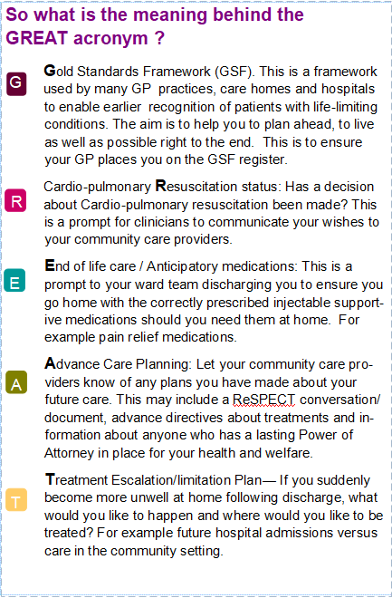


Slide 25
How do we plan to evaluate this project?
We will be repeating these audits at UHNM again and plan to look at larger numbers of patients. Reviewing the quality of e-discharge letters
Asking clinicians who are using the GREAT acronym for feedback- if you would like to feedback any concerns or comments please email: fiona.read@uhnm.nhs.uk or charmaine.butcher@uhnm.nhs.uk

Slide 26
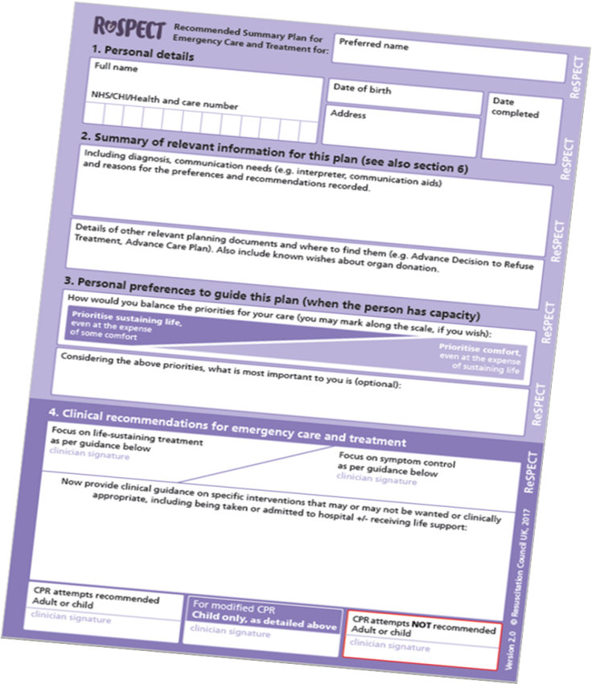
Other projects alongside the GREAT project - ReSPECT
ReSPECT stands for:
Re-Recommended
S-Summary
P-Plan for
E-Emergency
C-Care and
T-Treatment
http://www.uhnm.nhs.uk/OurServices/Pages/ReSPECT.aspx
Patients who have a ReSPECT form completed will be discharged with the original document, which stays with them, and a digital copy will be saved on iPortal.
A wealth of information about ReSPECT and supporting resources for health professionals is also available at www.respectprocess.org.uk

Slide 27
There will always be, for some patients and families, that the decision to come into hospital will be the right decision. They may wish to die in a hospital setting, particularly when they have built close relationships through their in-patient specialist units/services.
However there are many patients who say that they do not want to come into hospital or die in a hospital setting and for those patients we can do better.
By taking a more proactive approach, with earlier identification and assessment of patients needs, hospitals find that admissions, deaths and lengths of stay are significantly reduced.

Slide 28


Any Questions

Slide 29
References
GSF – Further information – Evidence that GSF helps reduce hospitalisation in all settings (admissions, hospital deaths, hospital bed days, rapid discharges home, re-admissions etc). http://www.goldstandardsframework.org.uk/cd-content/uploads/files/3%20%20%20Evidence%20%20vs%203%20that%20use%20of%20GSF%20reduces%20hosiptalisation(1).pdf
Link to GSF virtual learning zone : http://www.gsflearning.co.uk/
Meaney PA et al. Rhythms and outcomes of adult in-hospital cardiac arrest. Crit Care Med 2010; 38(1):101-8.
Perkins GD, Cooke MW. Variability in cardiac arrest survival: the NHS Ambulance Service Quality Indicators. Emerg Med J 2012; 29(1):3-5.
Lightning Learning: GREAT Palliative Discharge – East Midlands Emergency Medicine Educational Media. https://static1.squarespace.com/static/546e1217e4b093626abfbae7/t/5e21ef74ea165940539e1743/1579282296548/Lightning+Learning+-+GREAT+Palliative+Discharge+%28v1.1%29.pdf

