Slide 1
Hertfordshire Red Bag Hospital Transfer Bag
June 2017

Slide 2
Red Bag
The Red Bag goes with the Care Home resident on their journey from the Care Home with the ambulance to the hospital and back again.
The idea of the Red Bag is to improve hospital transfers and make sure that the right belongings, documentation and medication is going in to the hospital and coming out of hospital and that these stay with the resident at all times.
Benefits:
The bag will help hospital and Care Home staff to understand the patient’s medical background by providing them with the correct information quickly to give the most appropriate care to the resident, reduce complaints from missing belongings and improve the resident’s experience

Slide 3
What is the Red bag?
Click below to view an explanation video on You Tube
https://www.youtube.com/watch?v=Unrca7pG_gc

Slide 4
It is important that the bag follows the resident throughout their journey from the home to the hospital, throughout the hospital and back again.

Slide 5
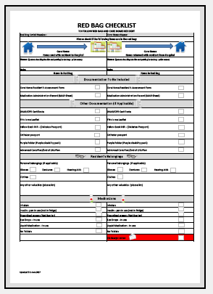
Completing the Checklist
1- Complete the checklist for the Resident once an ambulance has been called to check everything is in the bag.
Please note, only include items that are relevant to the resident e.g. This is Me
2- The Hospital will check the bag against the checklist and ensure the bag and its contents stays with the resident
3. The patient is ready for discharge, the hospital will complete the checklist to check everything should be in the bag.
4. Check the bag against the checklist once the resident has returned
5- Put the checklist into the patient’s records.

Slide 6
What goes into the Red Bag?
Documentation
Must be included:
Care Home Resident’s Assessment (or homes equivalent)
MAR Sheet
Checklist
Confidential paper at the top
If applicable to the resident:
DNAR/CPR
This is me leaflet
Diabetes Passport
Catheter Passport
Purple Disability Pack
End of Life care plan

Slide 7
What goes into the Red Bag? Medication
Only send in if applicable to resident
Medications to send in
IN USE:
Inhalers
Insulin Pen
Prescribed Creams (not barriers creams)
Eye Drops
Liquid Medication
Medications not to send in
Tablets
Patches
Multi Compartment Compliance Aid
Any other Control Drugs
Injections (other than Insulin)
Supplements and Feeds

Slide 8
What goes into the Red Bag? Personal Belongings
Only send in if applicable
Clothes:
Shirt or blouse
Jumper/Cardigan
Dress or Skirt
Underwear
Slippers/shoes/sandals
Nightwear
Toiletries
Personal aids:
Glasses
Hearing Aids
Dentures
Only include valuables if really necessary
Notes:
TOP TIP – if the clothes are soiled, put in a bag or the clothes to be returned in.

Slide 9
Resident does not return back to care home
If the resident moves to another care home or passes away in the hospital.
The bag will be cleaned by the hospital staff to reduce the risk of infection
The Impartial Assessors will then take the bag to HCPA offices, in Welwyn
The bag can either be collected from their office or will be dropped off if they are due to visit.

Slide 10
Next steps
Please share this information with your members of staff
We will be giving you today:
The Red Bags allocated to your care home
The folders with 1 copy of the documentation inside
Some posters for you to promote the scheme with
After the session:
HCPA will email you an electronic copy of all the documents
They can also be downloaded from www.hertsredbag.co.uk
Start using the Red Bag’s from the 3rd July

Slide 11
Questions, issues or feedback
There is a list of frequently asked questions on www.hertsredbag.co.uk
You can also email:
redbag@enhertsccg.nhs.uk

Slide 12
Any questions?

